Slide 1
KNN CLASSIFICATION WITH UNIVARIATE TIME-SERIES DATA
Camille Bustalinio
DSCI6008-Advanced Stats project

Slide 2
Data:
Sensor Readings on Temperature: by Minute, for 2 days
Data gathered simultaneously, in different parts of the venue
Object:
Classify sensors if they are in the same floor
Solution:
Use K-Nearest Neighbors: sensors close to each other will have similar readings

Slide 3
Classification
Machine Learning problem
Requires observations to be IID: Independent and Identically Distributed
Could be Multivariate: Multiple Features
Cross-Sectional: Data at a single point in time
KNN, Logistic Regression, Naïve Bayes
KNN:
Non-Linear
Uses a distance Metric
Classify based on N-nearest neighbors

Slide 4
Univariate Time Series
Data about a single feature, over multiple points in time
Autocorrelation: present value is not independent of past values
Collected over regular time-intervals
Successive: order of data is important
Seasonality

Slide 5
Using Time Series for Classification:
AUTOCORRELATION,
Seasonality

Slide 6
Euclidean Distance
ts1=pd.Series(3.1*np.sin(x/1.5)+3.5)
ts2=pd.Series(2.2*np.sin(x/3.5+2.4)+3.2)
ts3=pd.Series(0.04*x+3.0)
euclid_dist(ts1,ts2):
26.959216038
euclid_dist(ts1,ts3):
23.1892491903
link

Slide 7
Dynamic Time Warping
Algo resulting to a Distance Measure
+ Asynchronous
+ Time Lags
- Expensive to calculate

Slide 8
Speeding Dynamic Time Warping
Dynamic Time Warping, r
Limit distance calculation/ comparison to [ t-r : t+r ]

Slide 9
Speeding Dynamic Time Warping
Ui=max(qi−r:qi+r)
Li=min(qi−r:qi+r)
link

Slide 10
Solution: Use LB_Keogh metric for K Nearest Neighbors Classification!

Slide 11
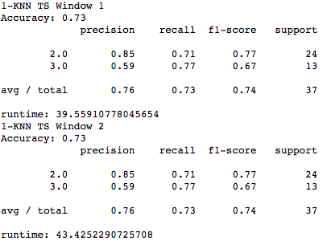
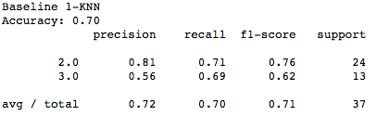
Results

Slide 12
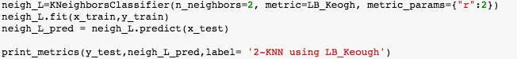
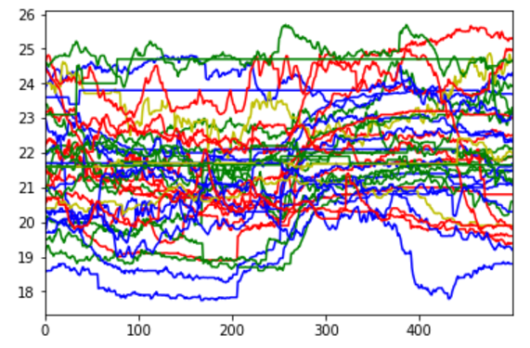
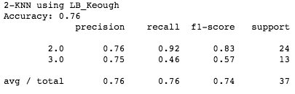
Best Model

Slide 13
Thanks!!!

